Slide 1
AI Foundation Course
AI ,ML ,DL , Generative AI , Agentic AI

Slide 2
What is Artificial Intelligence (AI)
AI (Artificial Intelligence) simulates human intelligence in machines.
Functions: Problem-solving, pattern recognition, language understanding, decision-making.
Learning: Uses data and algorithms to train models that improve over time.
Applications: Virtual assistants, recommendation systems, self-driving cars, chatbots.
Types:
Narrow AI (Weak AI)– Task-specific. Examples: Siri, Google Maps, ChatGPT, spam filters.
General AI (Strong AI)– Human-level intelligence. Still theoretical and under research.
Impact: Transforms industries by making processes smarter, faster, and more efficient.
Examples: Voice assistants, fraud detection, recommendation systems.

Slide 3
General AI (Strong AI)
Conceptual / Research Stage
Sophia Robot (by Hanson Robotics): Demonstrates human-like conversation and emotion recognition.
Artificial General Intelligence (AGI) prototypes: Projects by OpenAI, DeepMind, and Anthropic aim for multi-domain reasoning agents.
Self-learning Agents: Systems that can design, code, test, and improve themselves (still experimental).
AI Research Models: AGI simulators that learn both mathematics and language reasoning from scratch.

Slide 4
AI Defines: Machines performing human-like reasoning and decision-making.
Example: AI auto-assigns bug tickets to the right developer.
Workflow:
1. Collect data (past tickets)
2. Train model
3. Predict responsible team
4. Route automatically

Slide 5
Machine Learning (ML – Predictive AI)
Machine Learning (ML) is a subset of AI that allows systems to learn from experience without explicit programming.
🧠 Human Intelligence → (inspires) → 🤖 Artificial Intelligence
(AI mimics human thinking, but in code!)
ML (Machine Learning) is the brain of AI—it learns from data to make predictions or decisions.
"ML = AI's learning engine."
Focus: Develops algorithms to analyze data, identify patterns, and make decisions.
Learning: Improves performance over time using historical data.
Applications: Recommendation systems, fraud detection, image recognition, predictive analytics.

Slide 6
ML Defines: Uses data to learn patterns and predict outcomes.
Purpose:
Uses historical data to forecast or classify future outcomes.
How it works: Applies machine learning models (like regression, decision trees, or neural networks) to find patterns in data.
Example: Predict sprint delays using past velocity data.
Workflow:
1. Collect metrics
2. Train ML model
3. Predict delay
4. Display alert

Slide 7
Machine Learning (ML – Predictive AI)
Example (IT Software Development):
In a bug tracking system, Predictive AI analyzes past issues to predict which new module is most likely to have defects.
Predicts defect-prone modules before release.
In DevOps, Forecasts system downtime or performance degradation based on server logs.

Slide 8
Types of Machine Learning (ML – Predictive AI)
Feature | Supervised Learning | Unsupervised Learning | Reinforcement Learning
Data | Labeled | Unlabeled | Interaction-based (with rewards/penalties)
Output Known? | Yes | No | Learn optimal actions through trial/error
Common Algorithms | Linear Regression, SVM | K-Means, PCA | Learns by reward feedback
Use Case | Prediction, Classification | Pattern detection, Clustering | Self-driving car, playing chess
Goal | Predict outcomes or classify data | Find hidden patterns or groupings. | Learns by feedback over time
Examples | · Email Spam Detection (Spam or Not Spam) · Loan Approval (Approve or Reject based on data) · Image Classification (Dog or Cat) | · Customer Segmentation (Group customers by behaviour) · Anomaly Detection (Identify unusual patterns in network traffic) Detecting fraud in credit card transactions. · Association Rules Market Basket Analysis (Find products often bought together) | Learns by doing and getting feedback

Slide 9
Conversational AI
Definition: Chatbots that understand natural language.
Enables machines to understand and respond in natural language (text or voice).
How it works: Uses NLP (Natural Language Processing) and dialogue management to understand and respond contextually. Example: IT Helpdesk Chatbot resets passwords or checks status. Workflow:
NLP → Intent recognition.
Call backend API.
Respond to user.

Slide 10
Conversational AI
Example (IT Software Development):
Chatbot for DevOps team that answers questions like “Show deployment status” or “Restart the test server”.
Helpdesk assistant that interacts with developers to resolve tool or environment issues.
Chatbot for developers to query build status or deployment history.
AI Helpdesk assistant for ticket resolution and automation.
Common Algorithms / Models:
NLP + NLU (Natural Language Understanding)
RNN, Transformer-based models (e.g. BERT, GPT)
Dialogue Management Systems

Slide 11
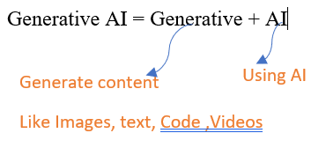
Generative AI
Definition: AI that creates new content (code, docs, images).
Purpose: Creates new content (text, code, image, design, etc.) using learned data patterns.
How it works: Uses deep learning models (like GPT or diffusion models) to generate original outputs.
Example: Generate API documentation or test cases from code. Workflow:
Input: code or description.
Model generates content.
Developer reviews & integrates.

Slide 12
Key Points:
How it works: Uses models like LLMs (e.g., ChatGPT, Gemini) and diffusion models (e.g., DALL·E, MidJourney) to generate human-like outputs.
Applications: Content creation, chatbots, code generation, art, drug discovery, and more.
Popular Models: GPT-4, Claude, Stable Diffusion, Sora (video generation).
Challenges: Ethical concerns (deepfakes, bias), copyright issues, and accuracy risks (hallucinations).
Generative AI is rapidly transforming industries by automating and enhancing creative and analytical tasks.

Slide 13
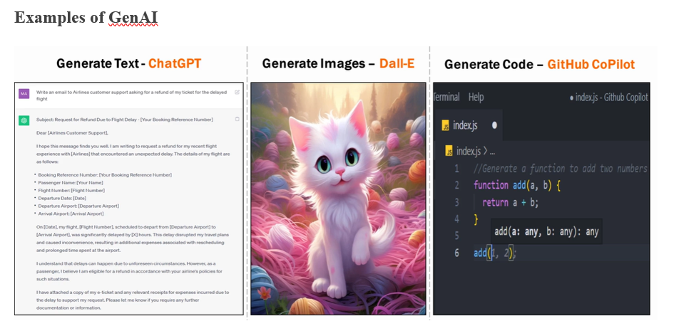
IT Example:
Generates source code, unit test cases, or technical documentation from natural language prompts.
Designs UI mockups from feature descriptions.

Slide 14
Generative AI Applications
Text Generation: ChatGPT, Google Gemini, Claude,Deepseek – writing, summarization, conversations.
Image Generation: DALL·E, Midjourney, Stable Diffusion – create images from text.
Audio & Music Generation: Jukebox, MusicLM – generate music or voice.
Code Generation: GitHub Copilot, CodeWhisperer – auto-generate code & functions.

Slide 15
Generative AI Applications
Video Generation: Sora, Runway ML – create videos from text prompts.
Video Editing & Manipulation: Runway ML, Pictory, DeepBrain – generate/edit videos.
Deepfake Creation: DeepFake Lab – face swap & synthetic videos.
3D Object Generation: NVIDIA GET3D – create 3D models for games, AR/VR.

Slide 16
AI Vs Generative AI:
● AI focuses on performing tasks and making decisions based on data, mimicking human behavior (e.g. recognizing images, responding to queries).
● Generative AI specializes in creating or generating new content from learned patterns, going beyond decision-making to creativity.
AI Type | Goal | Key Algorithms | IT Software Example
Predictive AI | Forecast future outcomes | Regression, Random Forest, LSTM | Predict software defects or downtime
Conversational AI | Understand & respond in language | NLP, BERT, GPT | DevOps/Helpdesk chatbot
Generative AI | Create new content | GAN, VAE, GPT | Auto-generate code or designs

Slide 17
Proprietary LLMs (Closed-Source / Commercial)
OpenAI GPT series – GPT-4, GPT-4o, GPT-5
Anthropic Claude series – Claude 3, Claude 3.5
Google Gemini – Gemini 1.5, Gemini 2.0
Microsoft Copilot Models
Cohere Command R+ (commercial version)
Amazon Titan Text
Perplexity LLM (Pro/Commercial versions)

Slide 18
Open-Source LLMs
Meta Llama series – Llama 2, Llama 3, Llama 3.1
Mistral AI models – Mistral 7B, Mixtral 8x7B, Mistral Large (partially open)
Google Gemma – Gemma 2B, Gemma 7B
Microsoft Phi series – Phi-2, Phi-3
HuggingFace Models – Falcon, BLOOM, Zephyr, StarCoder
Alibaba Qwen series – Qwen 2.5, Qwen Code
Snowflake Arctic
OpenHermes & OpenChat variants

Slide 19
SLM – Small Language Models
Definition: Small Language Models (SLMs) are lightweight AI models designed for specific domains or enterprise tasks.
They are smaller in size (few hundred million to a few billion parameters) compared to Large Language Models (LLMs) like GPT or Gemini — but are faster, cheaper, and easier to deploy on-premises or in private clouds.
Example: Internal chatbot using Mistral or Phi-3. Workflow:
Collect internal docs.
Fine-tune model.
Deploy internally.
Use securely.

Slide 20
SLM – Small Language Models
In software development or enterprise IT environments, SLMs are ideal for:
Internal automation (chatbots, document search, ticket resolution)
Secure environments (data stays within organization)
Resource-constrained deployments (edge servers, internal VMs)
Fine-tuned support for domain-specific vocabulary (e.g., DevOps logs, database terms, API names)

Slide 21
Example Use Case:
Scenario:
An IT service company wants an internal chatbot to help developers and testers query technical documentation, API references, and deployment procedures securely — without using public LLM APIs.
🧠 Solution using SLM:
Model Choice: Use Mistral-7B, Phi-3, or LLaMA-3 3B (smaller variants).
Training Data: Internal documents, project manuals, and API documentation.
Fine-Tuning: Use domain adaptation via LoRA (Low-Rank Adaptation) or parameter-efficient fine-tuning (PEFT) techniques.
Deployment: Host on internal servers using frameworks like Hugging Face Transformers, LangChain, or Ollama.
Usage: Employees chat securely with the internal model to get code snippets, configuration steps, or release notes.

Slide 22
SLM – Small Language Models
👉 Example Output (IT Use):
Prompt :- > Developer: “How to restart backend API after deployment?”
SLM Chatbot: “Use pm2 restart backend-service from the /opt/apps directory. Ensure config.json is updated before restart.”

Slide 23
What are LLMs?
Large–as it is trained on large amounts of data and billions of trainable parameters.
Language–as it deals with text data.
Model–as it predicts the next word/sentence/token.

Slide 24
LLM – Large Language Models
Definition: Large Language Models (LLMs) are AI systems trained on massive and diverse datasets (code, documents, websites, books) to understand and generate human-like text.
They have billions of parameters and can perform multiple tasks such as code generation, document summarization, bug explanation, chatbot interactions, and data analysis — all from natural language prompts.
Example: ChatGPT generates code or project summaries. Workflow:
Input query.
LLM processes.
Output human-like response.

Slide 25
LLM – Large Language Models
In the software development lifecycle (SDLC), LLMs are used to:
Assist developers in writing or debugging code.
Automate documentation and API design.
Generate test cases, SQL queries, and configuration scripts.
Analyze logs and suggest performance optimizations.
Support conversational IT agents for DevOps or helpdesk automation.

Slide 26
LLM – Large Language Models
Example Use Case:
Scenario:
A software company uses ChatGPT or LLaMA 3 70B to assist developers in their daily work.
🧠 Solution using LLM:
A developer asks: “Write a Python script to validate user input for email and mobile number.”
The LLM processes the request using its pre-trained knowledge of Python syntax and validation logic.
It generates:
import re
def validate_user_input(email, mobile):
return bool(re.match(r'^[\w\.-]+@[\w\.-]+\.\w+$', email)) and len(mobile) == 10 and mobile.isdigit()
The output can then be reviewed, tested, and integrated by the developer.

Slide 27
Workflow
1️⃣ Input query or prompt (text/code)
↓
2️⃣ LLM tokenizes input and applies attention mechanism
↓
3️⃣ Predicts next tokens to form coherent output
↓
4️⃣ Generates response (code, summary, design doc, etc.)
↓
5️⃣ User refines or re-prompts for improvement

Slide 28
Purpose | Algorithm / Model | Description
Base Architecture | Transformer | Uses self-attention for context understanding
Pre-training | Next-token prediction | Learns patterns from large-scale datasets
Fine-tuning | RLHF (Reinforcement Learning from Human Feedback) | Aligns responses to human preference
Optimization | Parallel training, quantization | For faster inference
Retrieval Enhancement | RAG (Retrieval-Augmented Generation) | Adds domain data dynamically to improve accuracy

Slide 29
Prompt: “Summarize recent commits for the billing module and suggest possible test cases.”
LLM Output:
Added payment gateway validation → create negative test case for invalid tokens.
Updated refund logic → verify reversal transaction logging.
Improved error messages → check localization and alert display.

Slide 30
Deep Learning (DL)
Definition: ML subset using neural networks with multiple layers to process complex data.
Example: Image recognition system that identifies cats in photos by learning from millions of cat images.

Slide 31
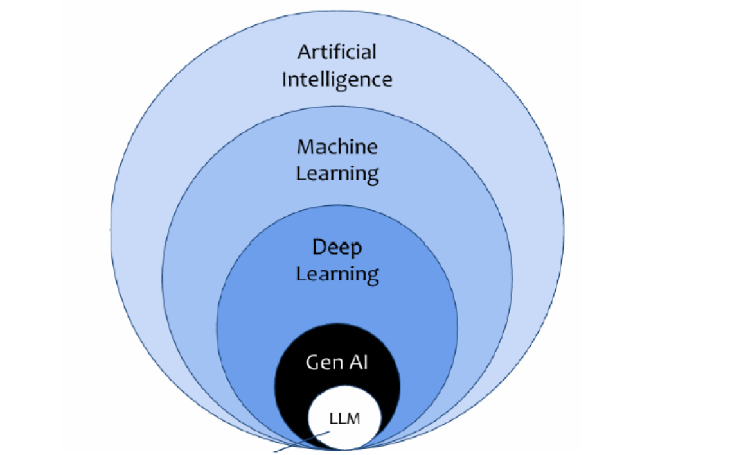

Slide 32
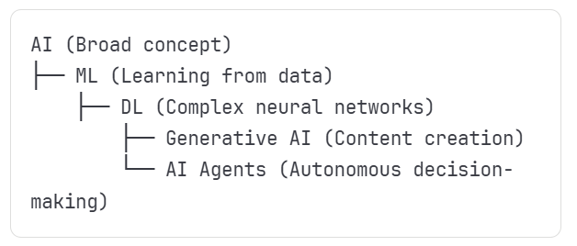
Technology Relationship Flow
Key Progression
AI: Rule-based intelligence
ML: Pattern recognition
DL: Complex pattern understanding
Generative AI: Creative content production
Agentic AI: Autonomous goal-oriented behaviour

Slide 33
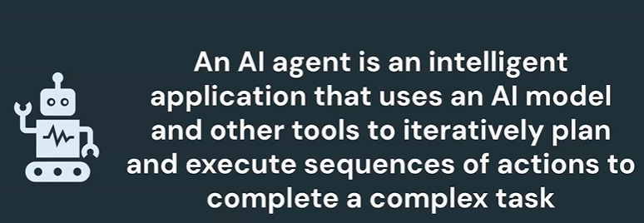
AI Agents / Agentic AI
Definition: AI systems that can perceive, reason, plan, and take autonomous actions to achieve goals.
Example: Self-driving car that observes traffic, plans routes, and makes driving decisions independently.

Slide 34
Agentic AI (Intelligent AI + RPA)
Definition: Combines AI reasoning with task automation.
Example: AI Testing Agent analyzes build logs and creates Jira tickets.
Workflow:
Perceive → Analyze → Act → Learn.

Slide 35
RAG (Retrieval Augmented Generation) (e.g HR SAKBOT)
Definition: Enhances LLM output using real data from Vector DB. Example: Developer asks about Azure CI/CD → RAG fetches company-specific guide. Workflow:
Store docs as embeddings.
Retrieve relevant text.
Combine with LLM for accurate reply.

Slide 36

RAG (Retrieval Augmented Generation) (e.g HR SAKBOT)
RAG Chatbot
LLM
Questions
Answers
SAK Data

Slide 37

Tool Augmented Chatbot
LLM
Questions
Answers
API
SAK Data
HR Management system

Slide 38



Onboard the new intern joining next Monday
Schedule welcome meeting
Create the intern’s profile in HR Management System
IT Helpdesk(Wi-Fi credentials , Email, Outlook
Assign Laptop, ID Card
This is an Agentic AI
Autonomous decision Making
Tool , knowledge, Memory
Goal Oriented Planning
Multistep reasoning

Slide 39
Prompt Engineering
Prompt
Definition: Crafting precise inputs for desired AI output.
A prompt is a detailed set of instructions or guidelines given to a Large Language Model (LLM) to perform a specific task.
It tells the model what to do, how to do it, and what kind of output is expected.
Example: “Write a PostgreSQL query to find top 5 customers”. Workflow:
Identify task.
Design structured prompt.
Test → Refine.

Slide 40
Prompt Engineering
Prompt engineering is the process of designing and refining prompts to get the best possible results from an LLM.
It involves creating task-specific prompts and improving them through trial and error (iterative process).

Slide 41
Simple Analogy
Prompt Engineering = Asking a good question.
Context Engineering = Giving extra background so the answer is smarter.
👉 Example in QA Automation:
Prompt Engineering → “Write Playwright script to test login page.”
Context Engineering → Provide UI element locators + business rules in advance, then ask for the script → More reliable automation code.

Slide 42
Why Developer ,QA/Testers Should Learn Generative AI
Automated Testing: Generative AI can create test cases, scripts, and scenarios, saving time and effort.
Bug Detection: AI can help identify potential issues in software by analyzing patterns.
Enhanced Creativity: Generative AI can assist in brainstorming new testing ideas or solutions.
Future-Proofing: As AI becomes more common in software development, learning generative AI ensures QA/testers stay relevant.

Slide 43
Prompt Version Control
Definition: Managing prompt templates and iterations. Example: Maintain Git repo of tested prompt templates. Workflow:
Save prompt versions.
Track performance.
Optimize or rollback.

Slide 44
Context Engineering
Definition: Managing what data/context the model receives. Example: AI remembers previous user query (“them” = open bugs). Workflow:
Capture conversation history.
Fetch relevant data (RAG).
Pass structured context to AI.

Slide 45
Prompt Engineering vs Context Engineering
Aspect | Prompt Engineering | Context Engineering
Definition | Crafting clear and effective instructions (prompts) to get the desired response from an AI model. | Designing and structuring the surrounding information (context) the model sees, to improve accuracy and relevance.
Focus | What you ask (the wording of the question). | What the model knows (extra background or data provided).
Example (Database) | Prompt: “Write a SQL query to fetch top 5 employees by salary.” | Context: Provide the database schema first, then ask → “Based on this schema, write a SQL query to fetch top 5 employees by salary.”
When Useful | Quick tasks, one-off instructions. | Complex workflows, business apps, or when AI needs history, rules, or knowledge base.
Outcome | AI gives output directly based on prompt. | AI uses both prompt + context → more accurate, tailored results.

Slide 46
The vibe coding philosophy
Vibe coding is less about writing every line of code and more about guiding AI tools with your vision and domain knowledge. It’s an iterative process of prompting, reviewing, and refining.
Conceptualize First
Domain Knowledge is Power
Iterative Development
https://docs.replit.com/tutorials/vibe-coding-101#the-vibe-coding-philosophy

Slide 47
Efficient prompting with Replit AI
https://docs.replit.com/tutorials/effective-prompting
Clear, concise, and context-rich prompts are the foundation of effective vibe coding with Replit AI. Think of prompting as giving precise instructions to a very capable—but literal-minded—assistant like Replit Agent or Replit Assistant. Guiding these tools effectively helps you go from idea to app, fast.

Slide 48
Sample Prompts used:
Prompt 1: write test cases for a shopping cart feature
Prompt 2: Generate test cases for an ATM machine
Prompt 3: Write a test automation script in selenium java for the following steps. 1) Open google.com 2) search for text selenium 3) click on search button 4) validate results.
Refer this file :- C:\Training Data\Prompt Engineering Training_updated\Gen AI with Testing cases\3.Prompt+Engineering.docx

Slide 49
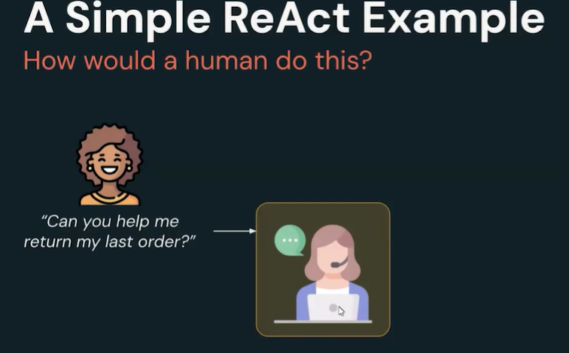

Slide 50
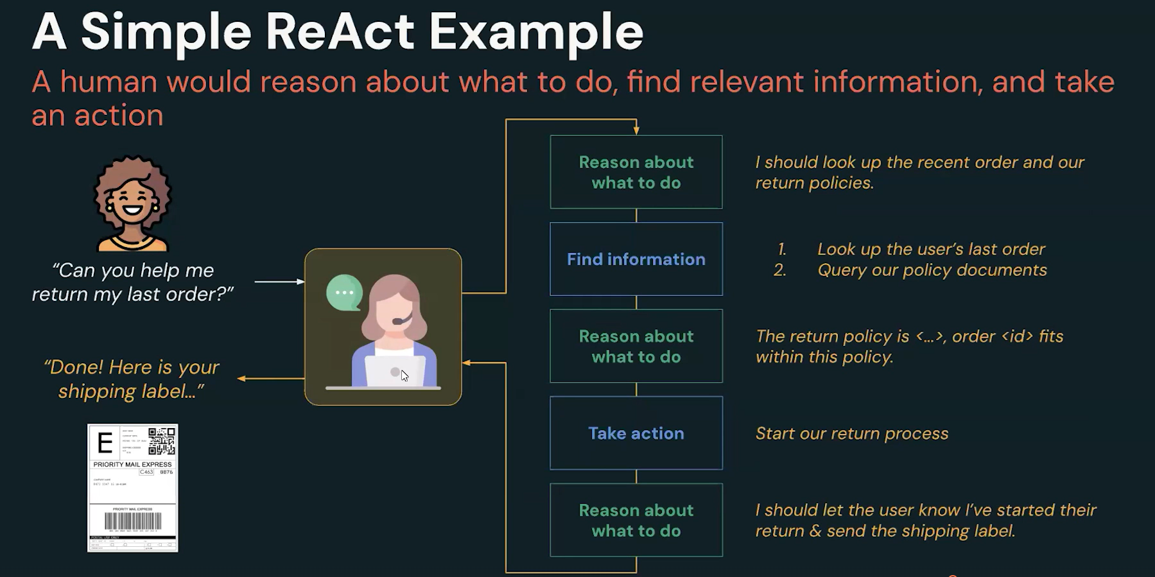

Slide 51
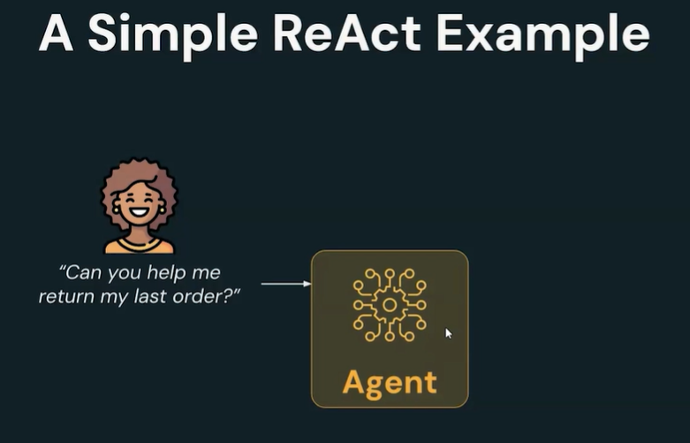

Slide 52
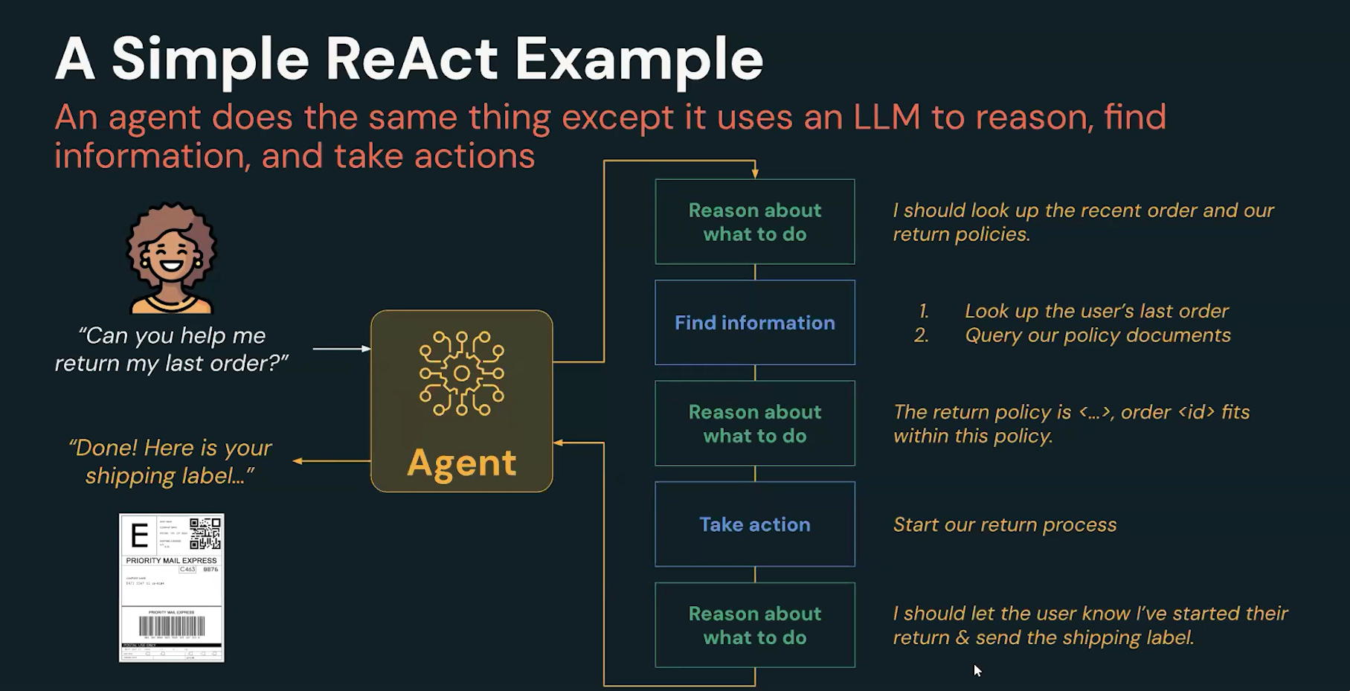

Slide 53
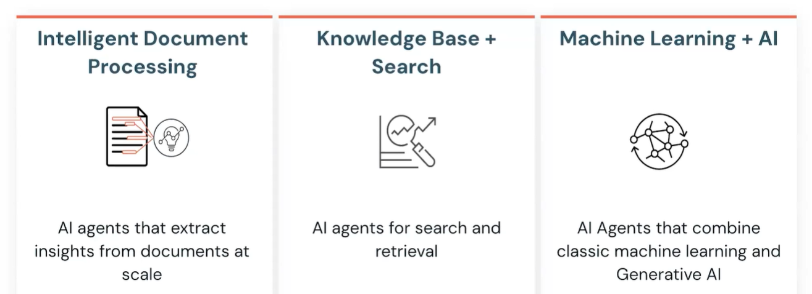
AI Agents Use Cases

Slide 54
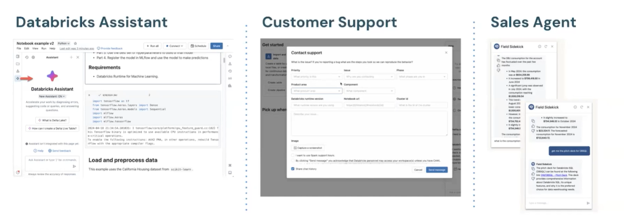
Databricks AI Agents

Slide 55
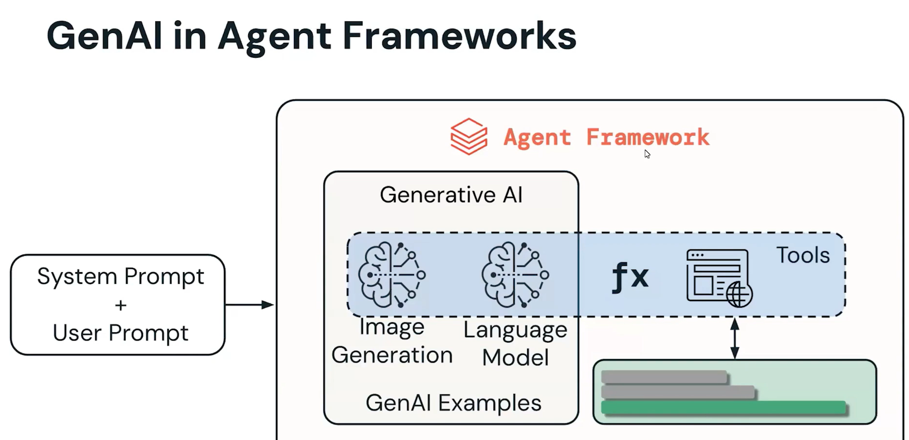
Chain-of-Thought

Slide 56
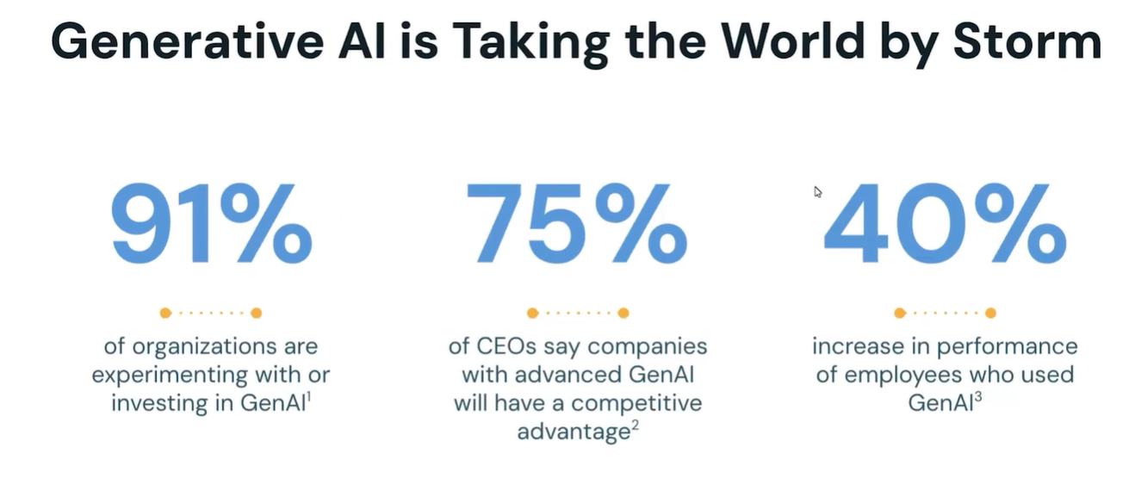

Slide 57
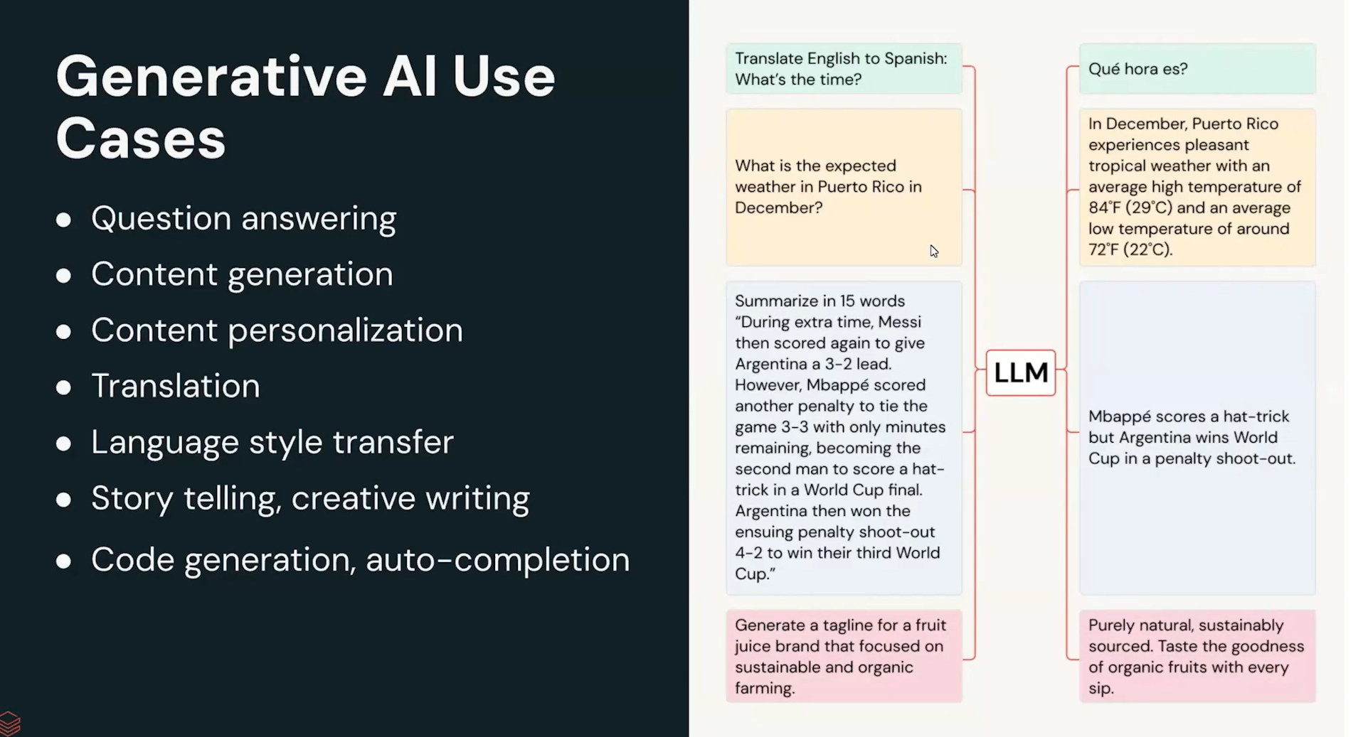

Slide 58
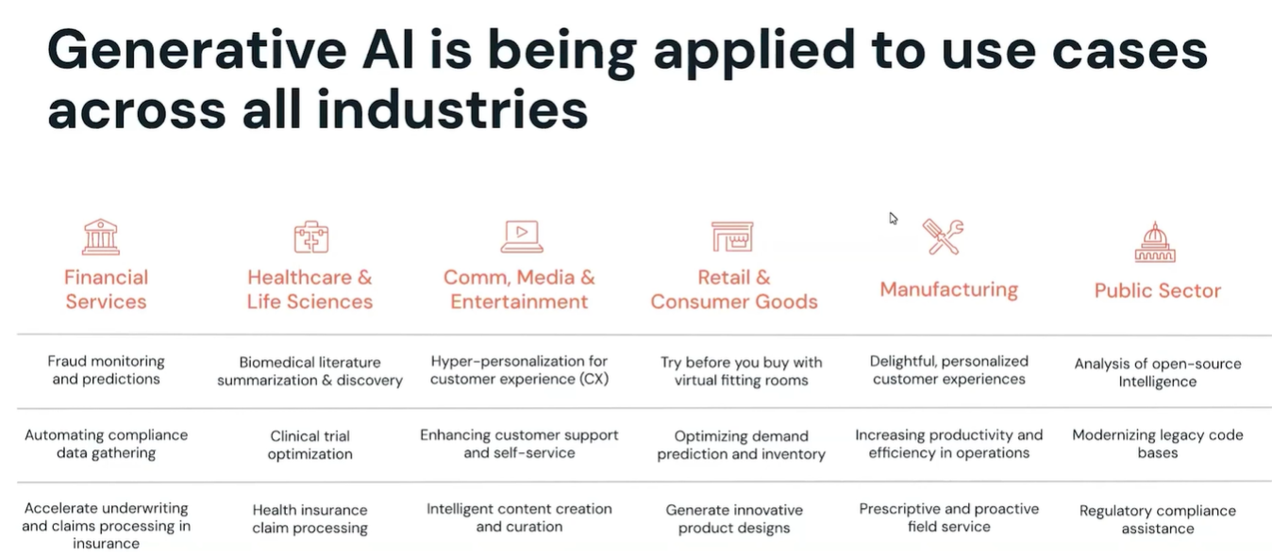

Slide 59
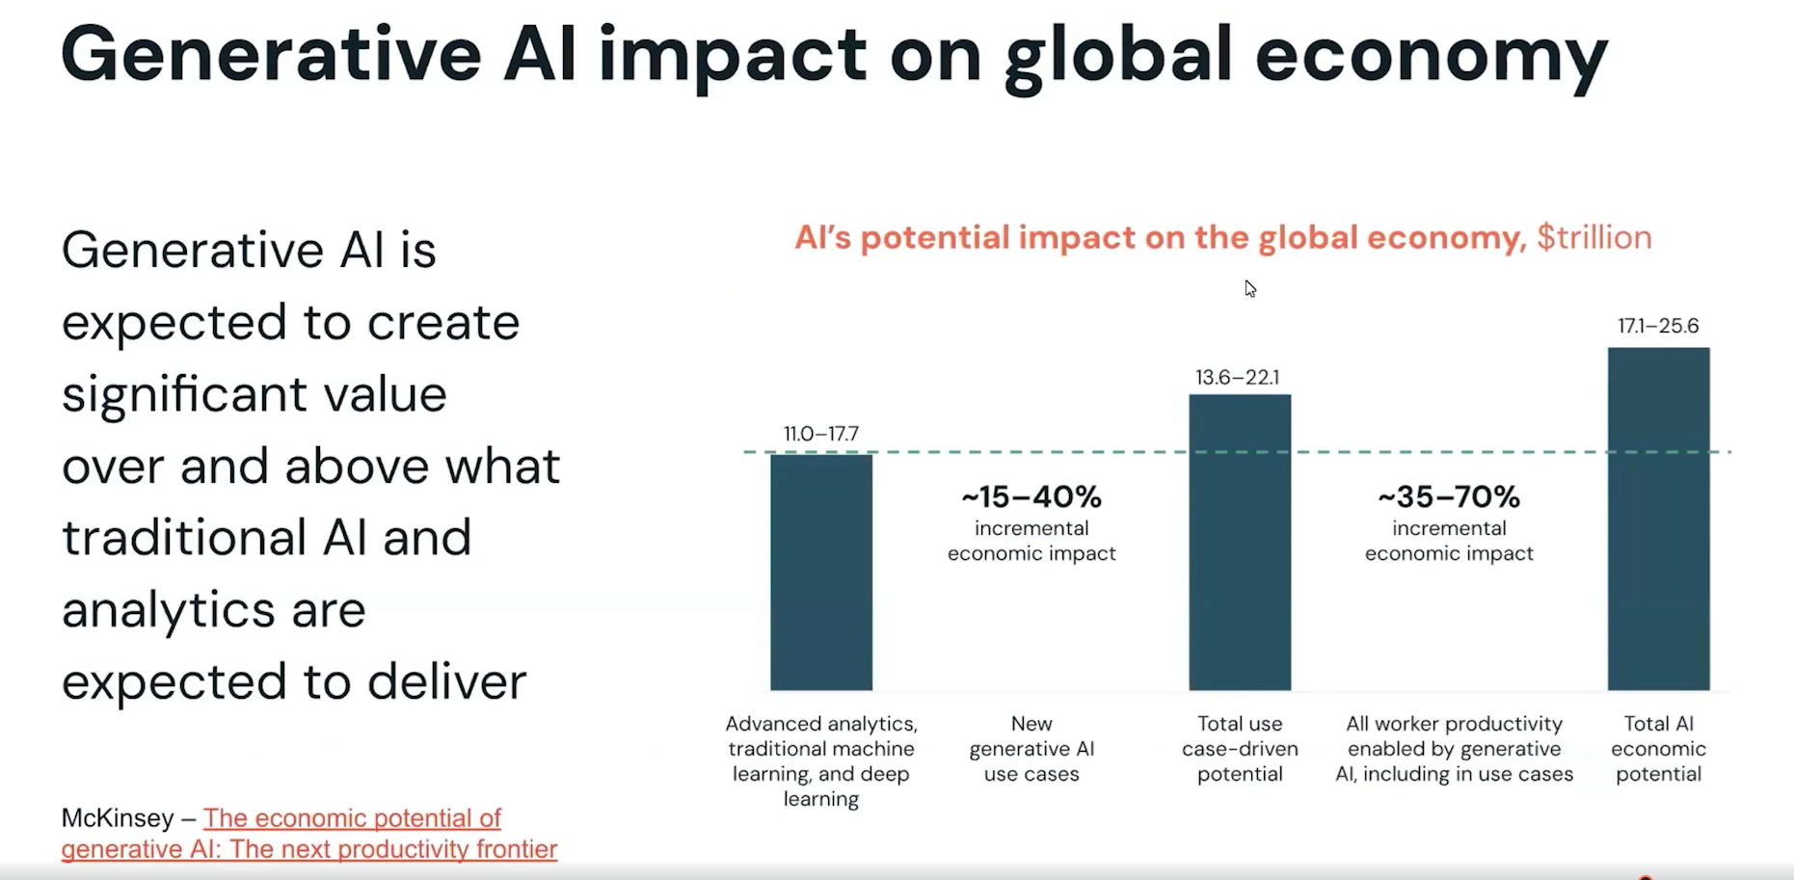

Slide 60
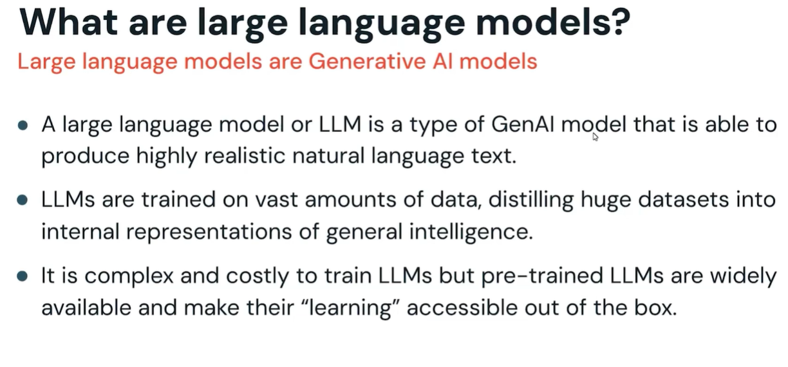

Slide 61
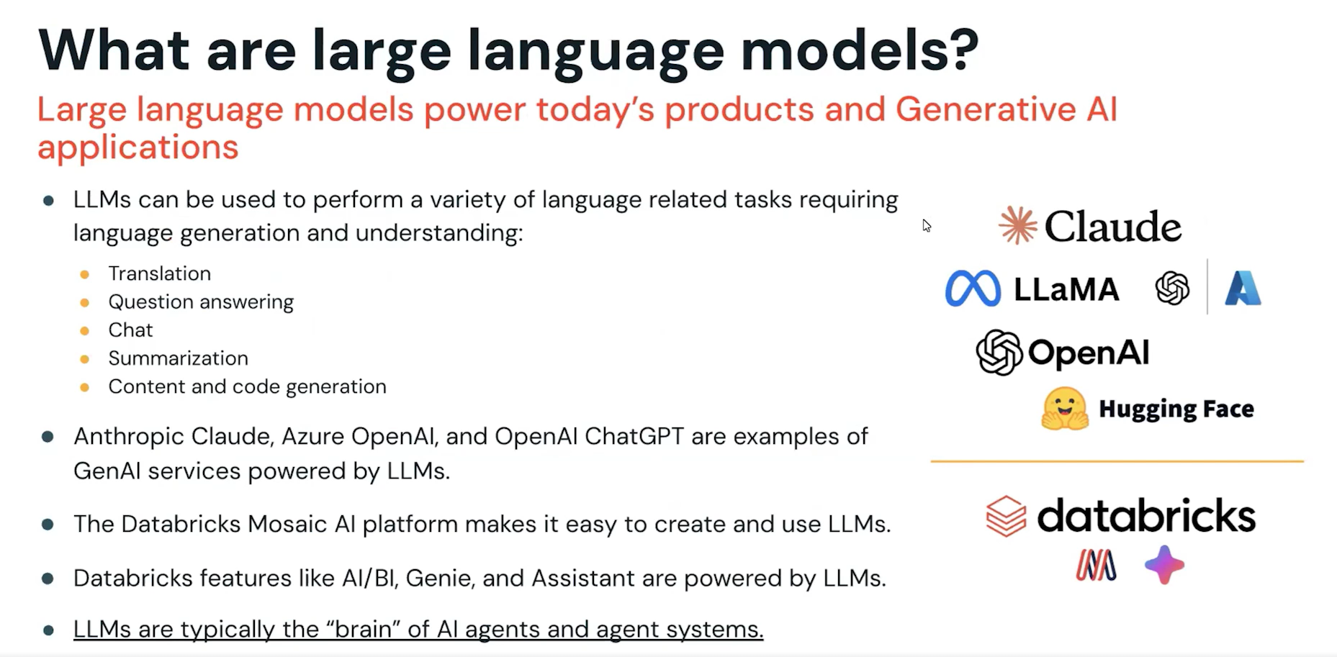

Slide 62
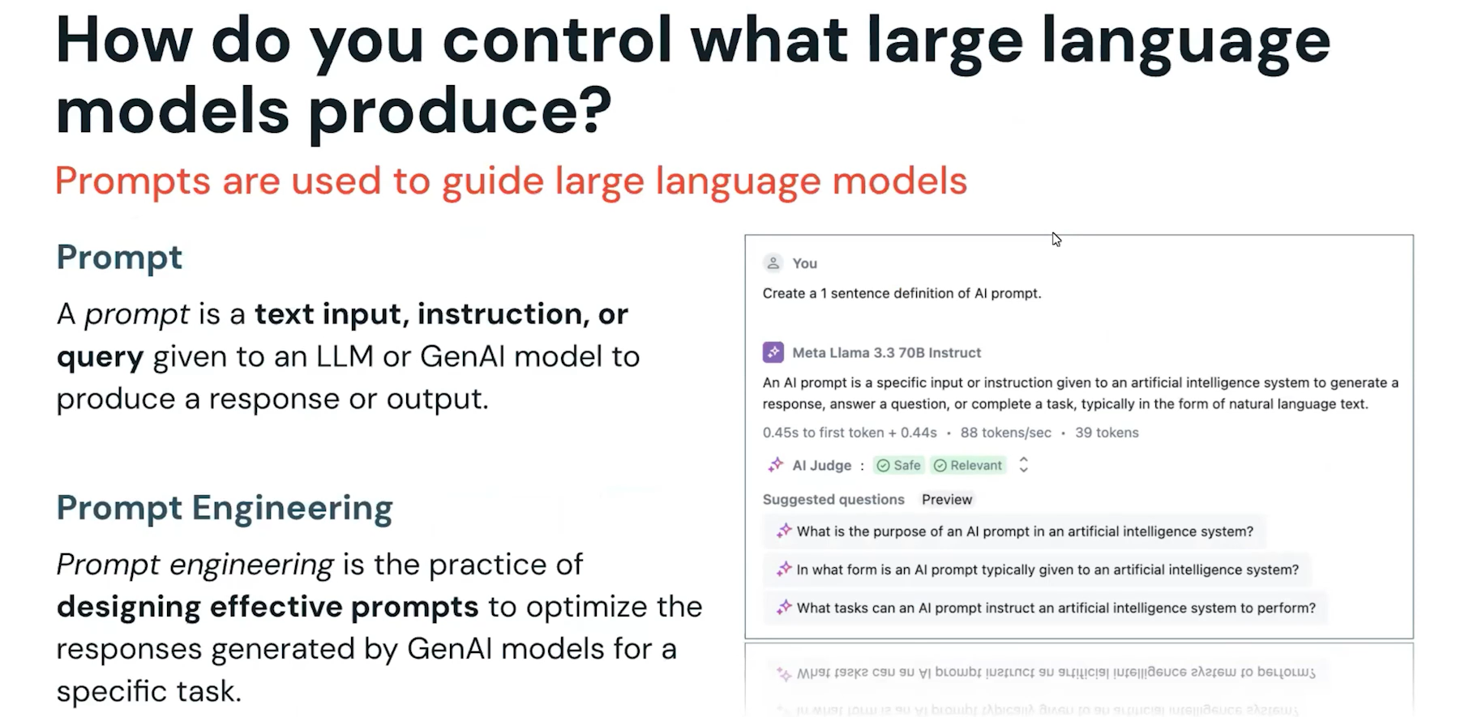

Slide 63
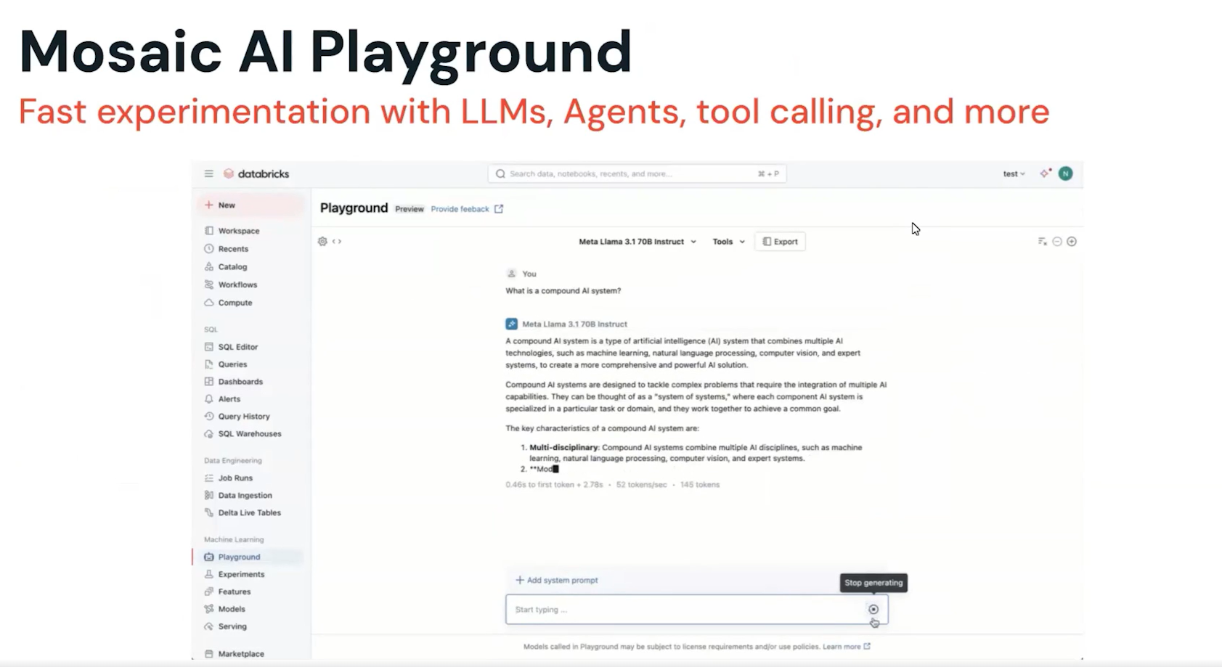
Chain of Thought

Slide 64
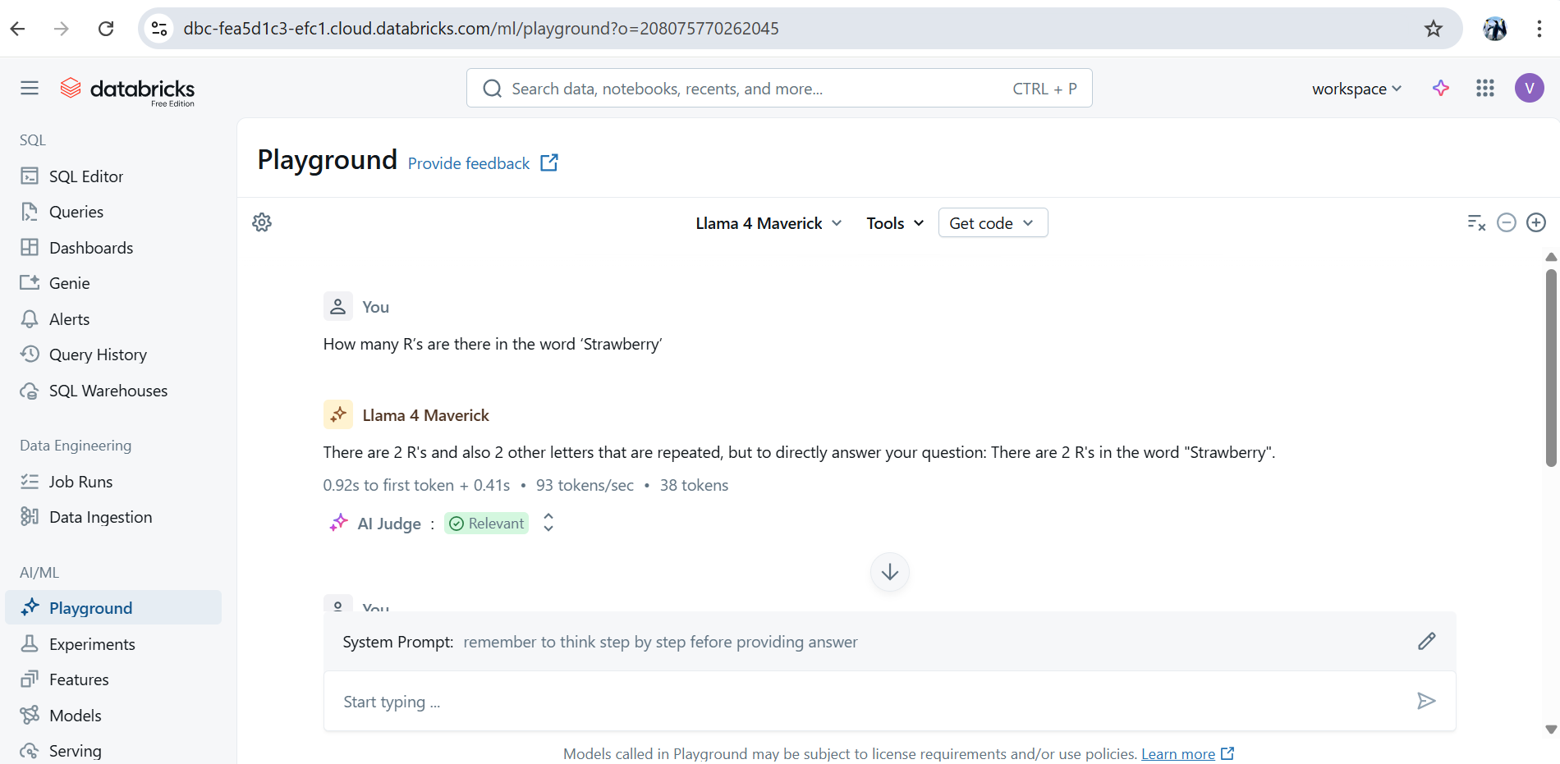

Slide 65
Prompt:- How many R’s are there in the word ‘Strawberry’
System prompt – remember to think step by step fefore providing answer
And again ask same question as
Prompt:- How many R’s are there in the word ‘Strawberry’
So Llam 4 maverick model gives you 3 R as correct answer.

Slide 66
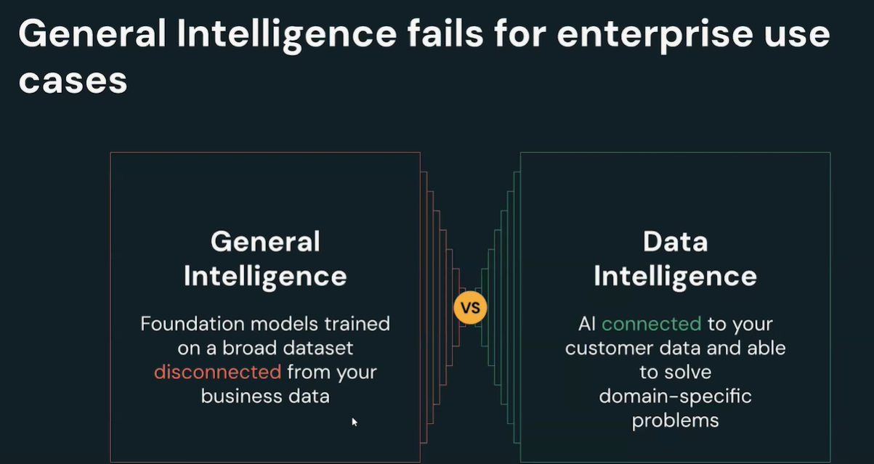

Slide 67
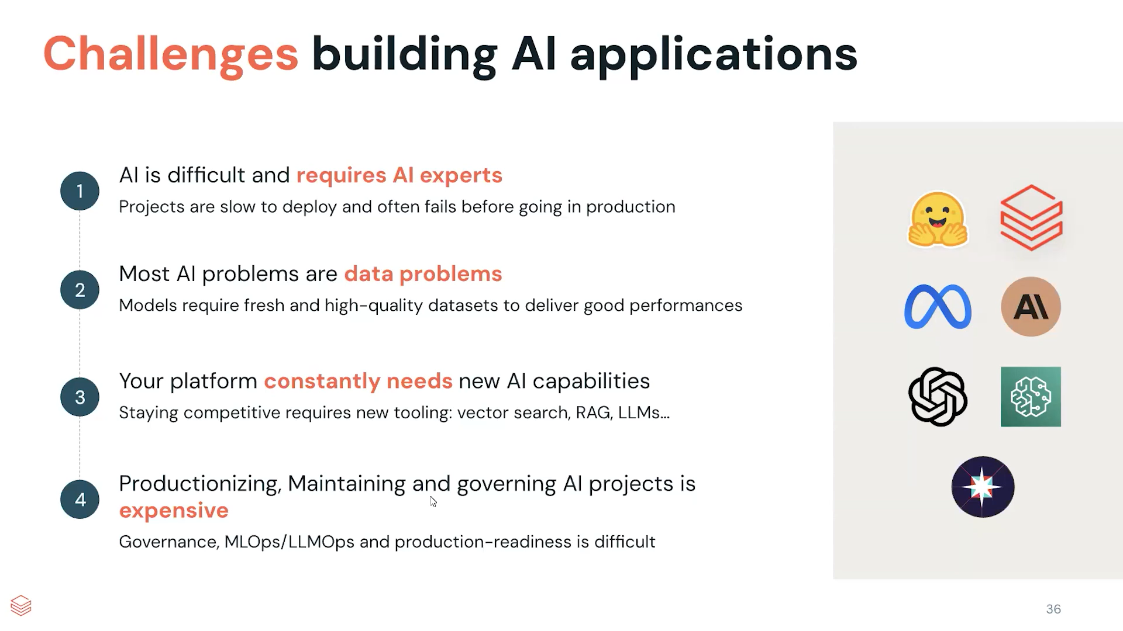

Slide 68
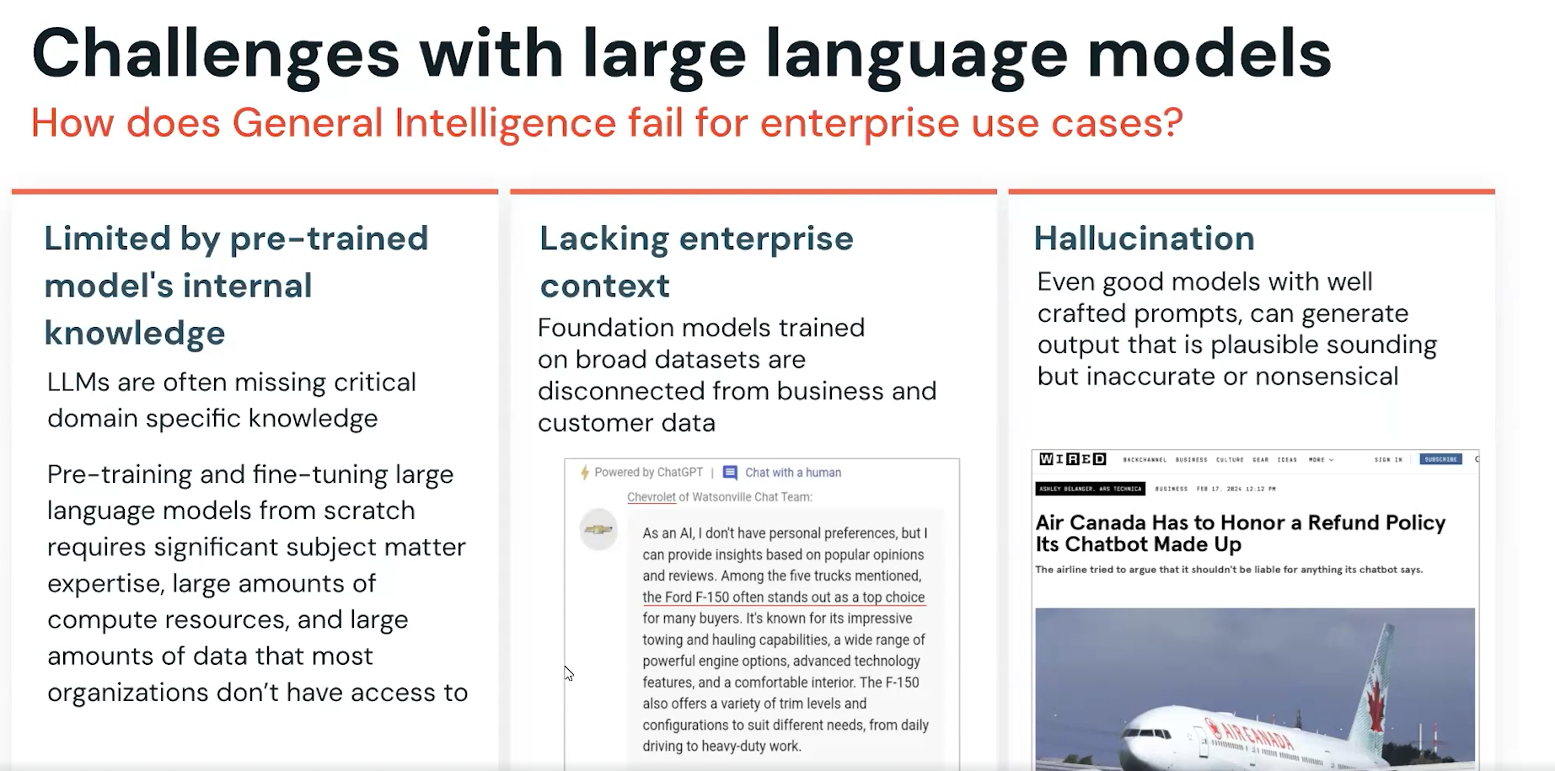

Slide 69
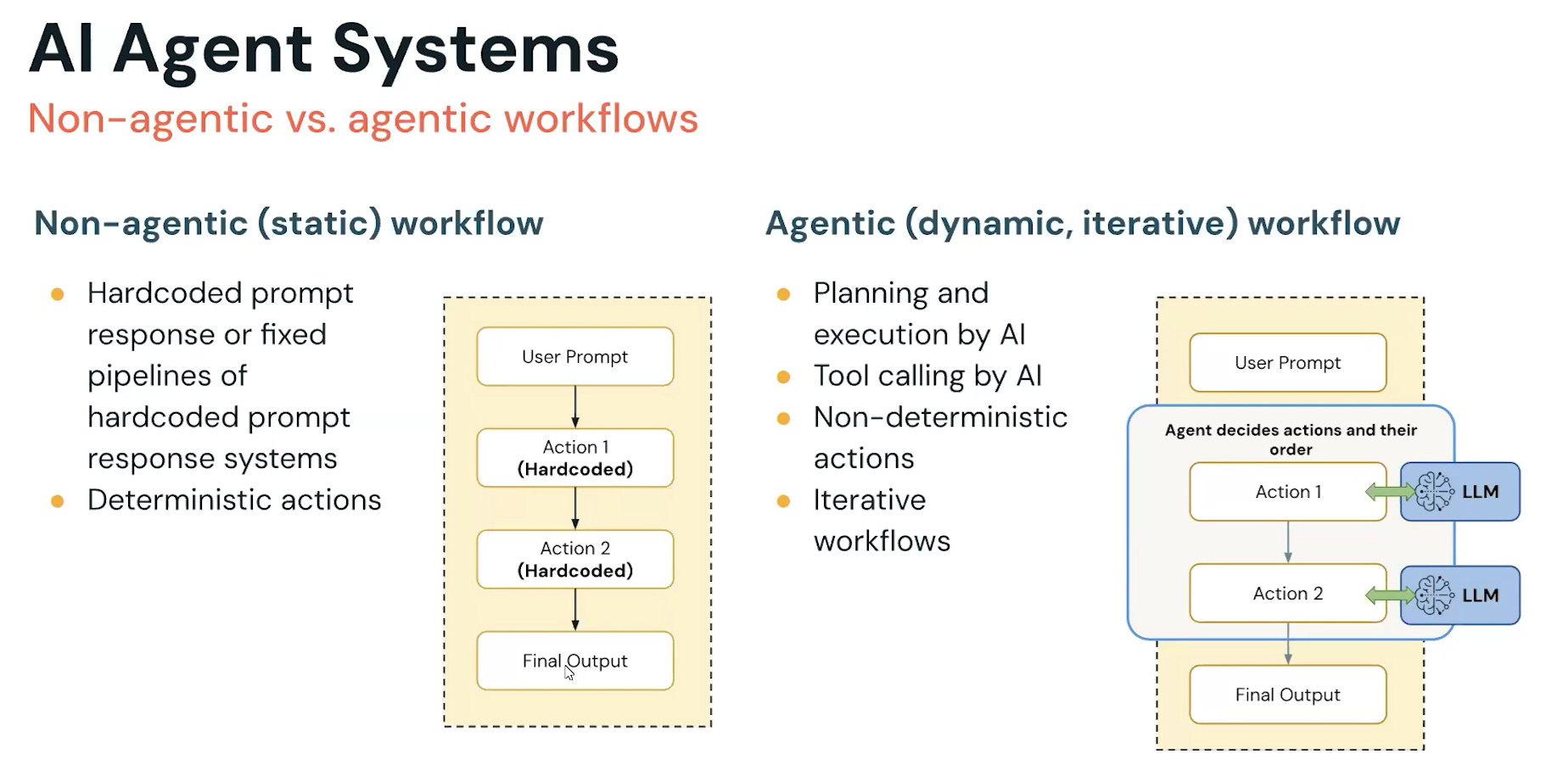

Slide 70
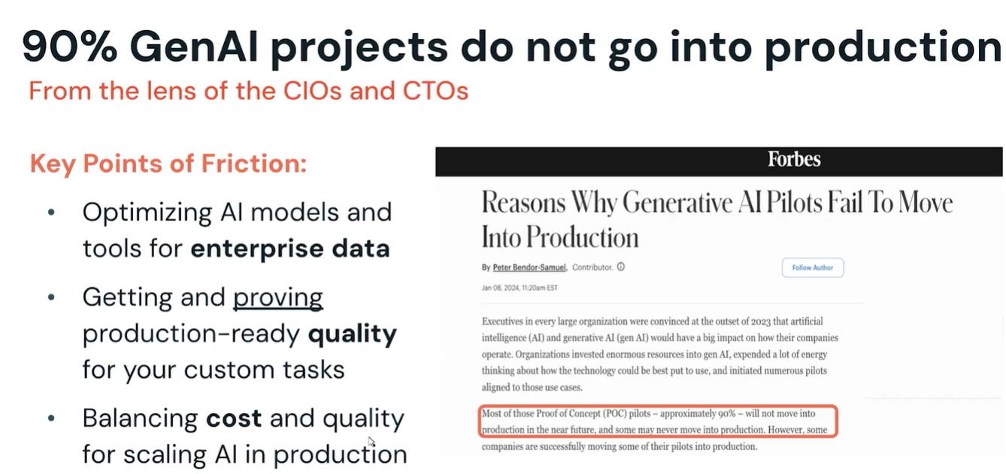
Building Agents with Databricks –Productionizing Agents

Slide 71
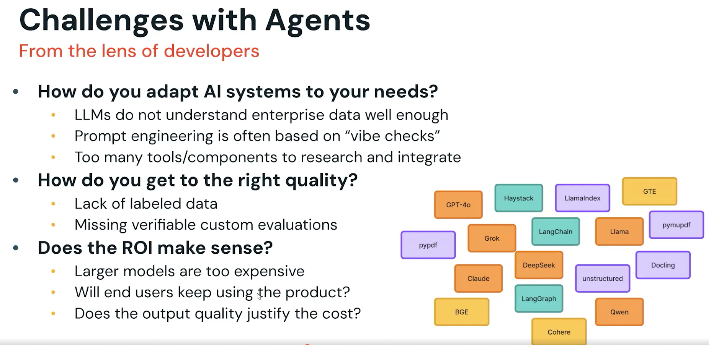

Slide 72
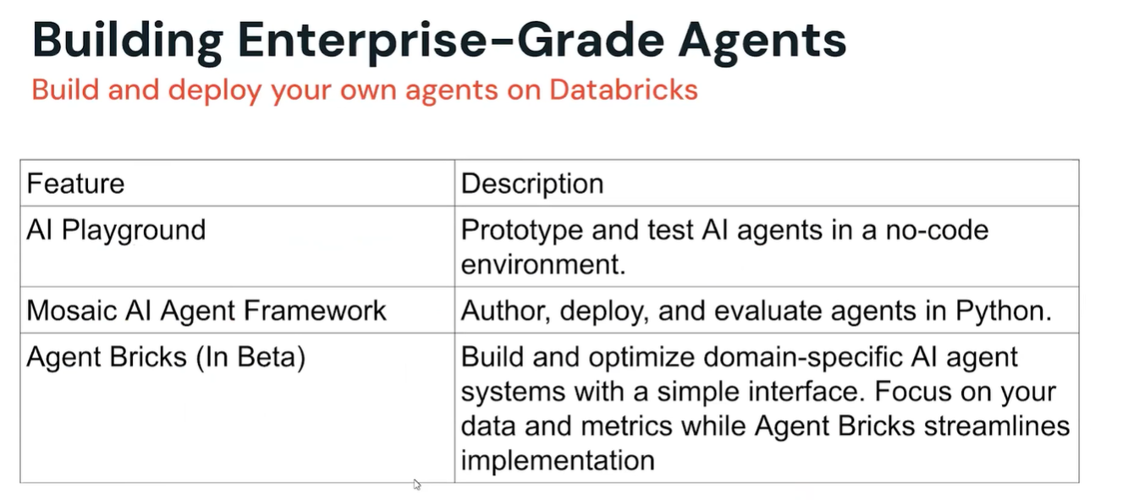

Slide 73
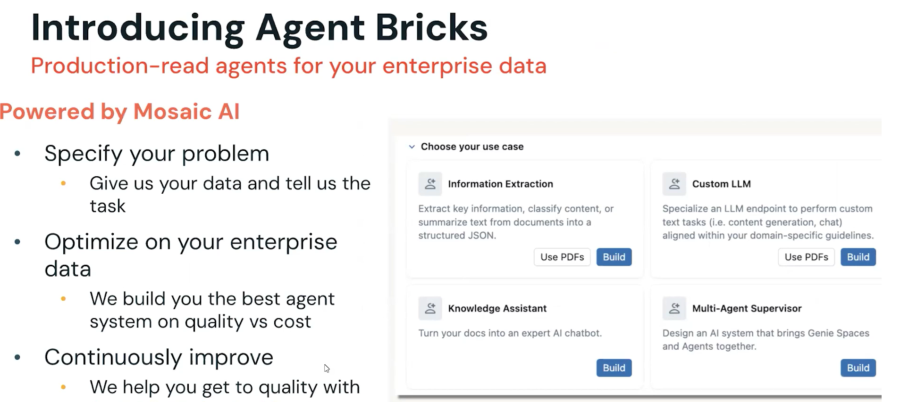
Agent learning on Human Feedback

Slide 74
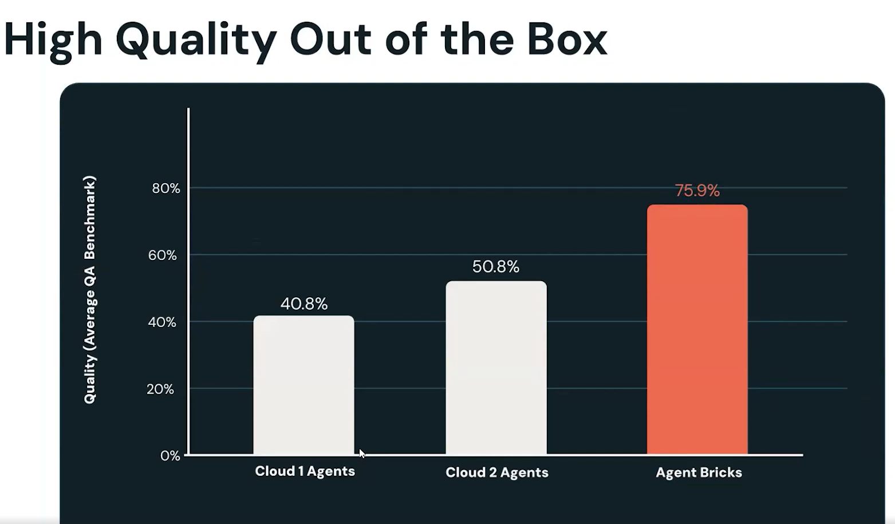
Agent Bricks(In Beta)

Slide 75
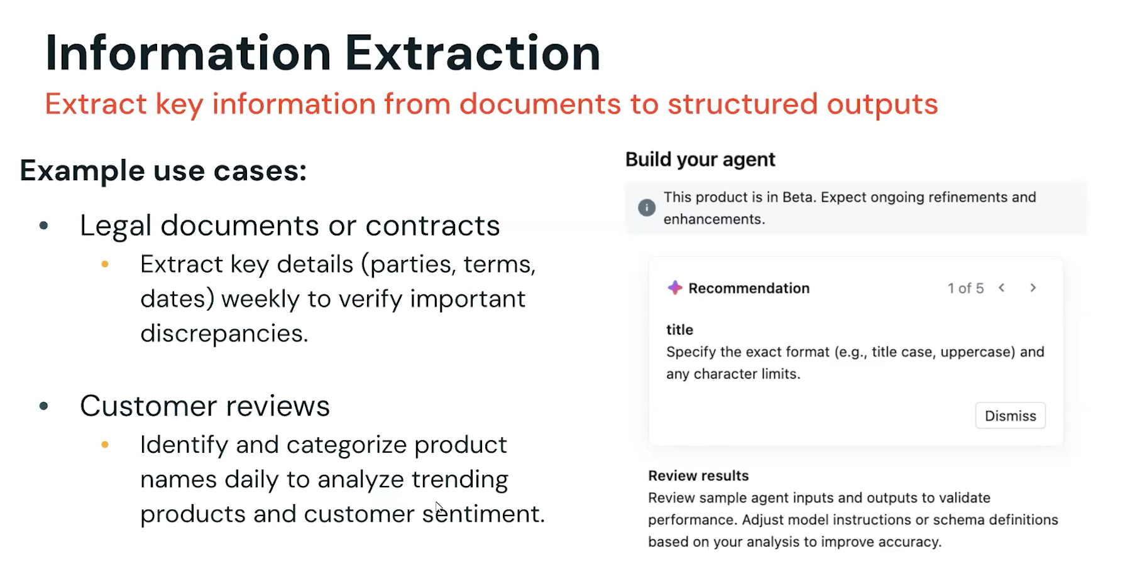

Slide 76
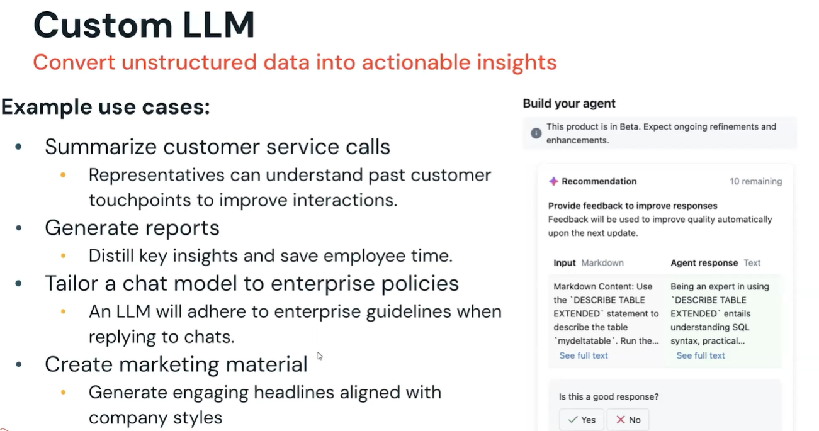

Slide 77
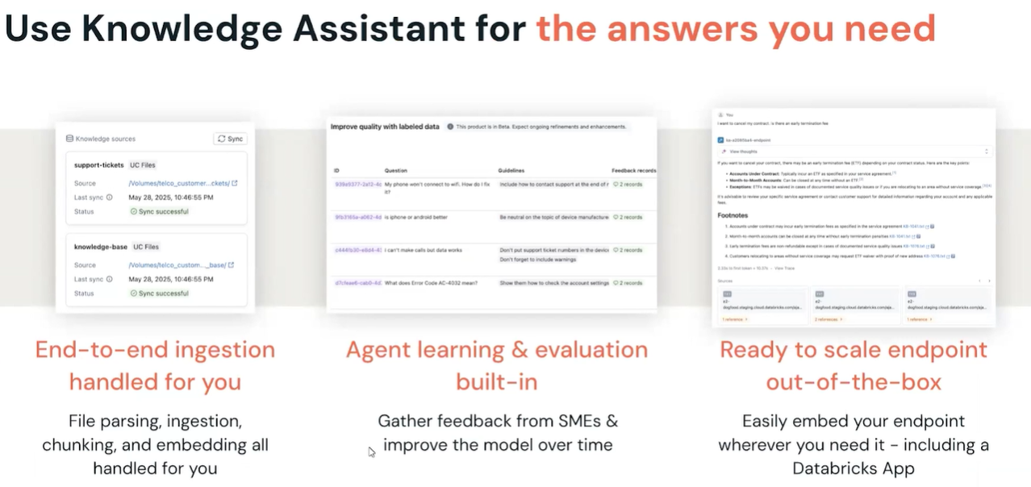

Slide 78
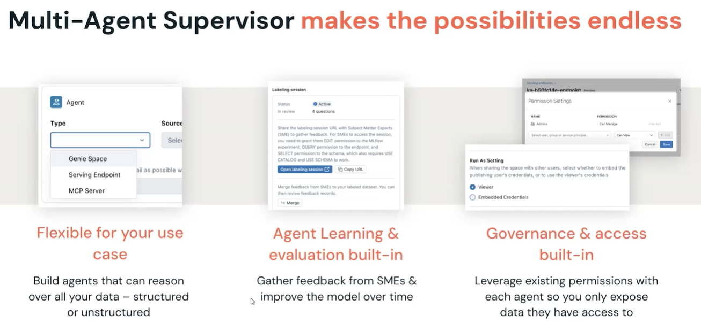

Slide 79
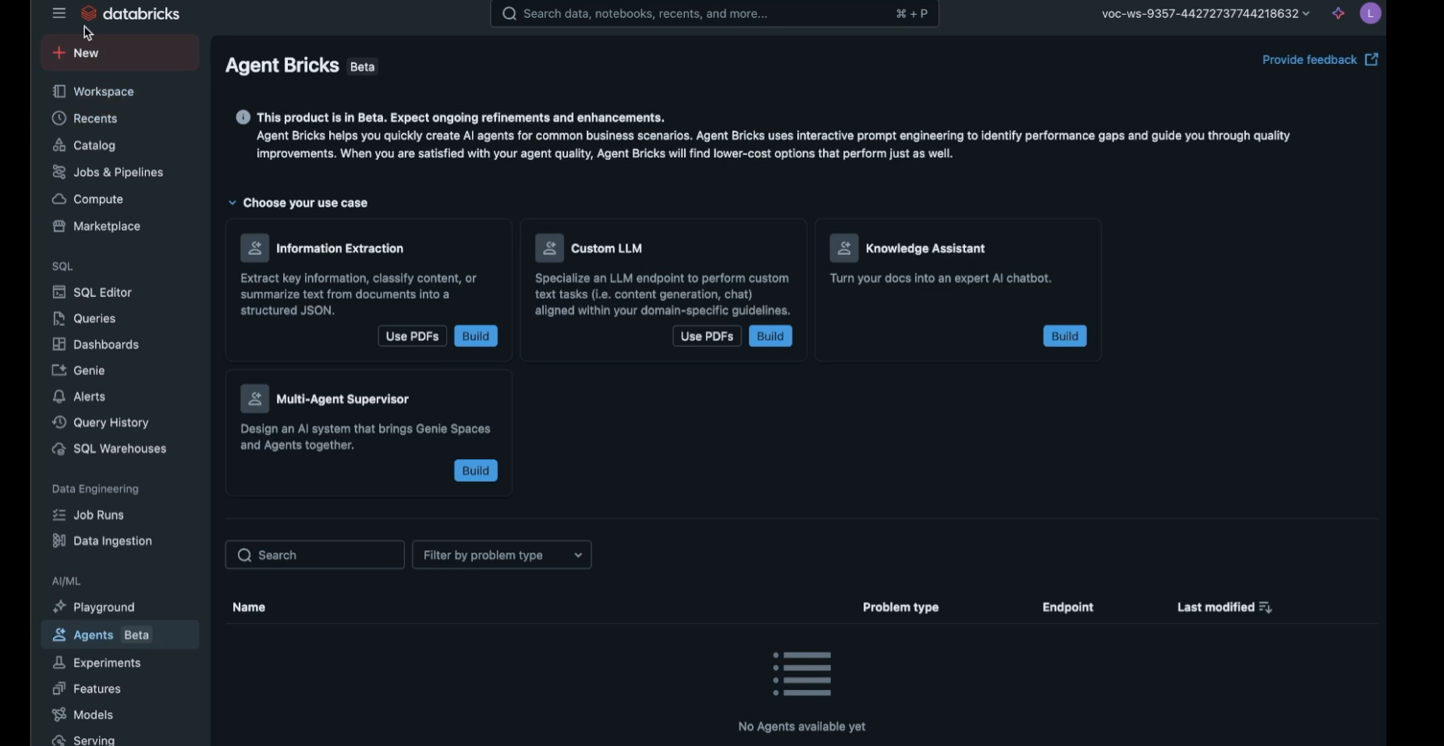
Information Extraction with Agent Bricks

Slide 80
Agentic AI is an autonomous system that sets and pursues its own goals, making decisions and taking actions independently to solve complex problems.
Model Context Protocol (MCP)
MCP is like a universal connector that lets AI (like ChatGPT, Claude, etc.) talk safely with outside tools and data sources.
Instead of being “stuck” with only what it was trained on, the AI can use MCP to fetch real-time data or trigger actions in software.
This makes the AI more useful, accurate, and reliable in business tasks.

Slide 81
🔹 Without MCP: You ask an AI: “What’s the stock price of Microsoft right now?” → AI might not know, because its training data is old.
🔹 With MCP: Through MCP, the AI connects securely to a stock market API → fetches the live price → gives you the correct, up-to-date answer.
👉 Think of MCP as a power socket: the AI is the device, and MCP lets it plug into different “power sources” (databases, APIs, apps) without needing custom wiring every time.

Slide 82
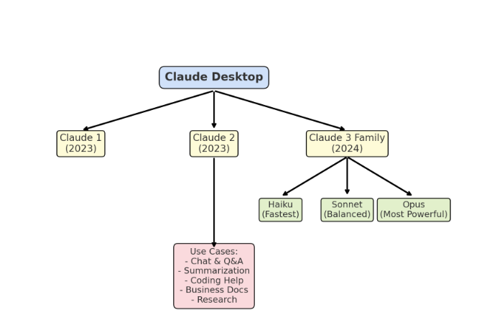
Claude Desktop and its models
Claude Desktop = easy desktop access to Claude AI.
Claude Models = 3 generations → Claude 1 → Claude 2 → Claude 3 (Haiku, Sonnet, Opus).
Claude is a next generation AI assistant built by Anthropic and trained to be safe, accurate, and secure to help you do your best work.

Slide 83
Comparison about AI , ML , DL , Generative AI , AI Agents , Agentic AI with real and current example
https://claude.ai/public/artifacts/cae7ed4c-39da-473b-b51b-33dca454fc55

Slide 84
Prompt Engineering vs Context Engineering
Aspect | Prompt Engineering | Context Engineering
Definition | Crafting clear and effective instructions (prompts) to get the desired response from an AI model. | Designing and structuring the surrounding information (context) the model sees, to improve accuracy and relevance.
Focus | What you ask (the wording of the question). | What the model knows (extra background or data provided).
Example (Database) | Prompt: “Write a SQL query to fetch top 5 employees by salary.” | Context: Provide the database schema first, then ask → “Based on this schema, write a SQL query to fetch top 5 employees by salary.”
When Useful | Quick tasks, one-off instructions. | Complex workflows, business apps, or when AI needs history, rules, or knowledge base.
Outcome | AI gives output directly based on prompt. | AI uses both prompt + context → more accurate, tailored results.

Slide 85
Simple Analogy
Prompt Engineering = Asking a good question.
Context Engineering = Giving extra background so the answer is smarter.
👉 Example in QA Automation:
Prompt Engineering → “Write Playwright script to test login page.”
Context Engineering → Provide UI element locators + business rules in advance, then ask for the script → More reliable automation code.

Slide 86
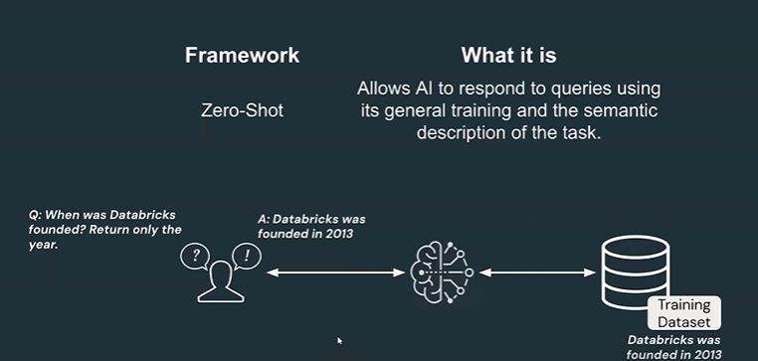

Slide 87
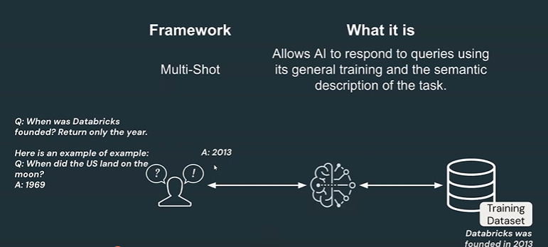

Slide 88
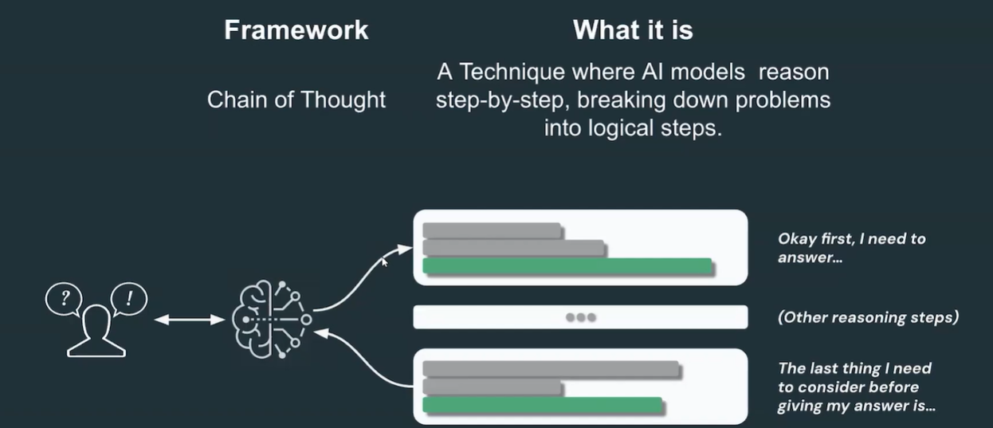

Slide 89
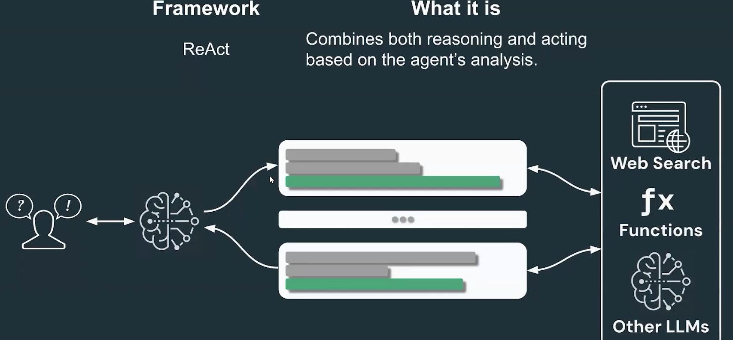

Slide 90
Thank you
Notes:
Client Overview
The Client is a territorial police force responsible for policing a city in North West England. The service area is 647 square kilometres with a population of around 1.5 million. As of March 2009 the service has 4,494 police officers, 2,221 staff, 442 police community support officers and 420 special constables.
Business Challenge
The Client had a conventional data management system in place. They were unable to replace it due to security concerns. The Client was looking for a trusted partner who can replace an existing system with an advanced Business Intelligence tool. They wanted to deliver accurate and relevant crime information from their central data warehouse to a set of users to enable data driven business decisions.
Business Solution
Acuma initiated a migration to Microsoft BI by installing the necessary software and prototyping the functionality needed for a large number of reports and dashboards. After understanding the existing functionality, Acuma recommended using SQL Server Reporting Services and then other tools as further capabilities are identified. The result was a successful proof of concept and overall solution design for the migration and detailed approach and estimates to complete the work.
On successful completion of the prototyping phase, Acuma team began the live migration with the following deliverables:
Platform installation and configuration of the latest Microsoft BI tools
Development of new reports and migration of existing reports and dashboards
Customised BI Portal
Migration of existing functionalities to the new platform
Support for UAT and Go-live
Desk side support, knowledge transfer and user training to the BI team on the Microsoft products
Apart from the original solution, Acuma also provided features such use of maps to identify various types of crime clusters as well as potential lawbreakers who reside in or commit crime in the local area.
Business Benefits
An integrated view of the crime and incident data that allows the Client to make data driven decisions
Increased data credibility and easy access to critical information
‘N’ number of reports are generated daily

